Slide 1
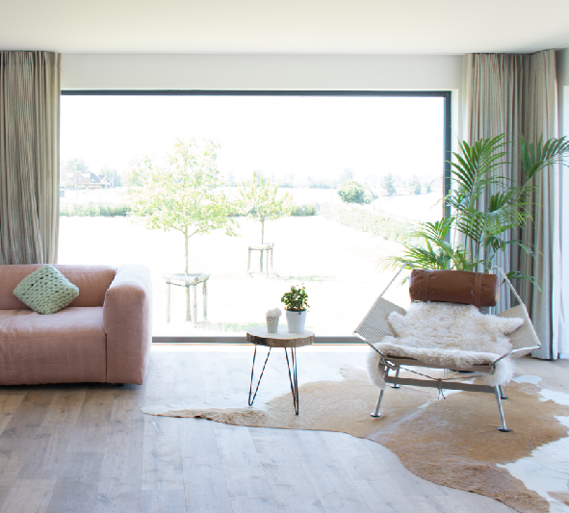
CONTENT
Who is Lamett?
Roots and milestones
The brand
Our strengths
Type of customers
Product mix
Morava Wood

Slide 2
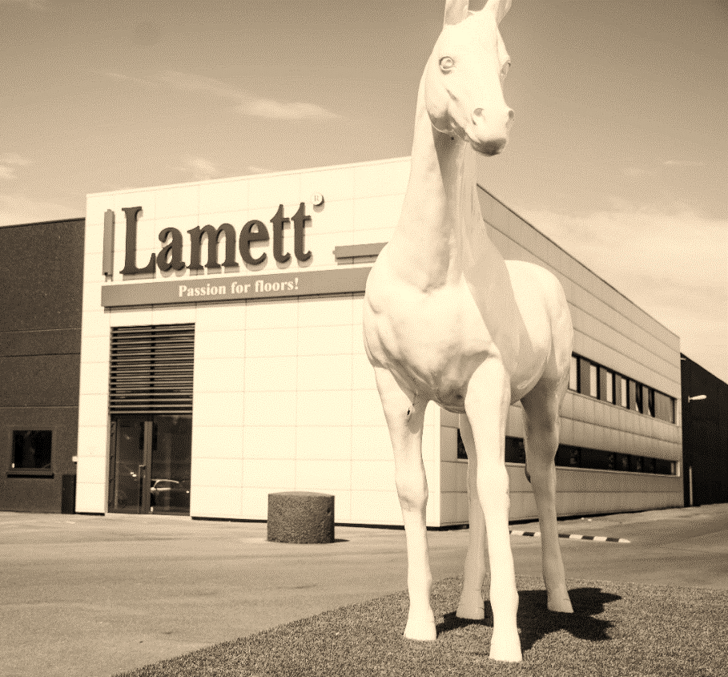
Lamett is…
a flooring expert: Parquet and ParquetVinyl
a producer and distributor
a sales & marketing organisation
has a 24/7 service team

Slide 3
CONTENT
Who is Lamett?
Roots and milestones
The brand
Our strengths
Type of customers
Product mix
Morava Wood

Slide 4
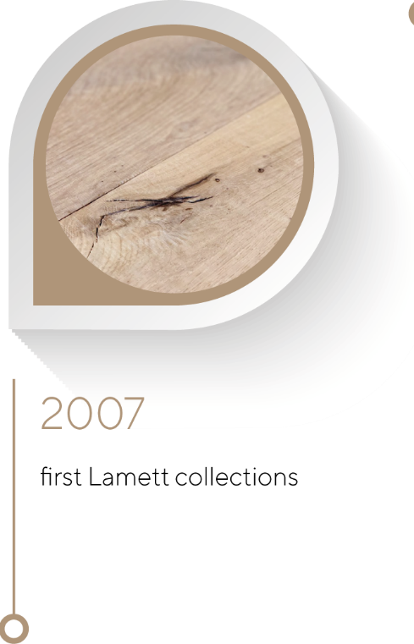
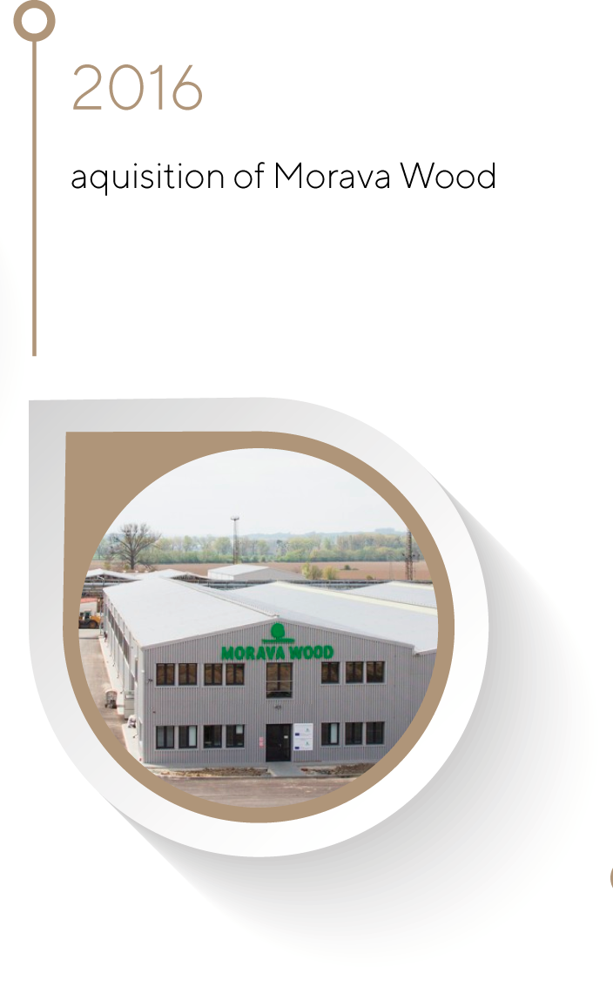
Roots & milestones

Slide 5
CONTENT
Who is Lamett?
Roots and milestones
The brand
Our strengths
Type of customers
Product mix
Morava Wood

Slide 6
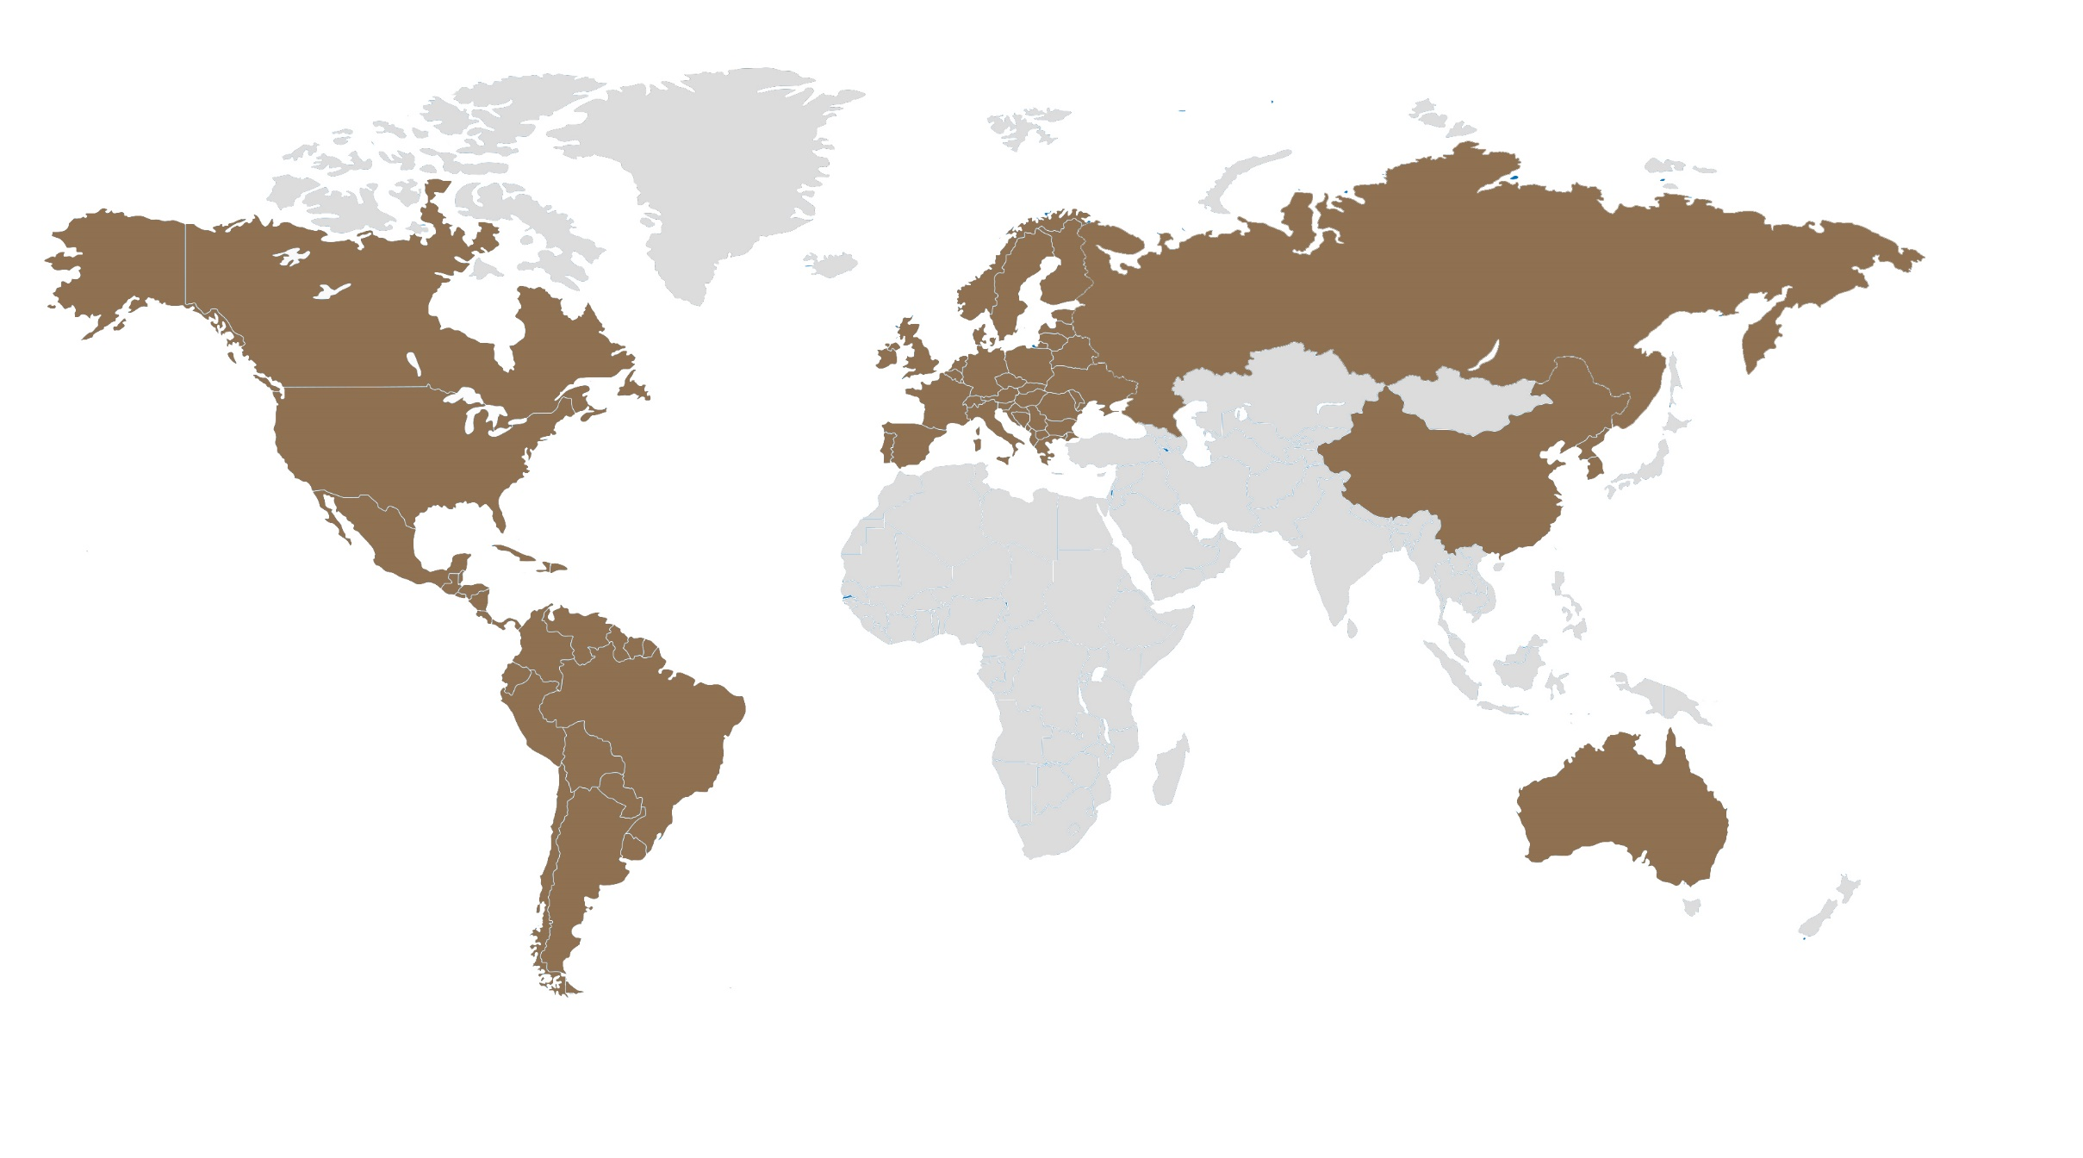
Lamett in the world
Manchester
Shanghai
Dallas
Moscow
Deerlijk
Melbourne

Slide 7
Lamett Europe key countries
Scandinavia
UK
the Netherlands
Belgium
Germany
France
Spain

Slide 8
CONTENT
Who is Lamett?
Roots and Milestones
The Brand
Our Strengths
Type of customers
Product Mix
Morava Wood

Slide 9
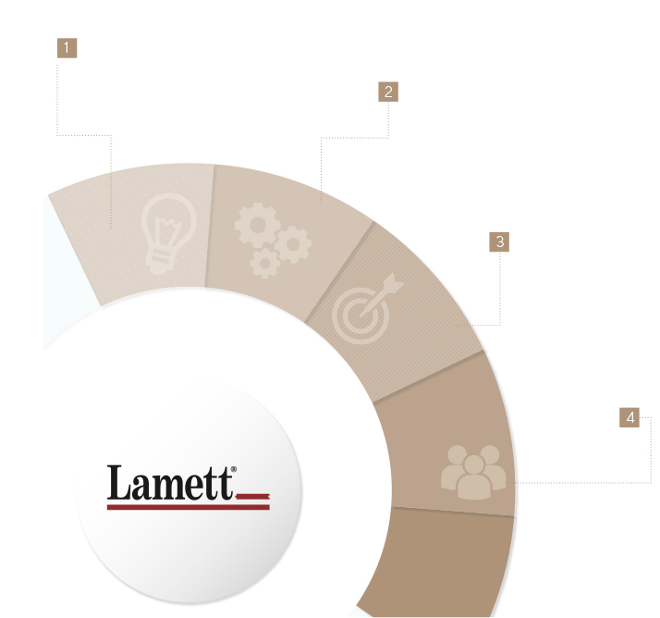
Our strengths
DESIGN
Continuous trend-watching to create commercial best sellers
Enhanced marketing tools
Creativity in product structures and finishing
DIVERSIFICATION
Multiple sales channels
International ambition
Well balanced offer to meet customer expectations in terms of product and budget
QUALITY
Reliability and performance
Continuous pursue of control processes to ensure top quality
Long term relationship with our partners
SERVICE
High inventory level
In-house competence
Driven to respond & solve issues efficiently

Slide 10
CONTENT
Who is Lamett?
Roots and milestones
The brand
Our strengths
Type of customers
Product mix
Morava Wood

Slide 11
Sales channels
1
Specialty retail
2
Architects
3
Wholesale
4
DIY retail
5
Contract business
6
Industrial business

Slide 12
CONTENT
Who is Lamett?
Roots and milestones
The brand
Our strengths
Type of customers
Product mix
Morava Wood

Slide 13
Our product mix
total turn-over € 45 mio
50%
35%
15 %
75%
25%

Slide 14
covering a wide range of price levels € 30 - € 150
€€€
covering all styles
light rustic – very rustic
€
clean/
light rustic
very rustic

Slide 15
CONTENT
Who is Lamett?
Roots and milestones
The brand
Our strengths
Type of customers
Product mix
Morava Wood

Slide 16
Morava Wood is…
100 % vertically integrated production facility of solid wooden floors
located at Unicov (North East of Czech Republic)
fast and continuous wood processing to ensure the manufacturing of a high quality finished product with permanent monitoring of the wood moisture

Slide 17
Roots & milestones
total production plant surface 20.000 m²
120 employees
sales volume of 600.000 m²
turnover 15 mio EUR
modern, well-equiped production facilities houses
state-of-the-art machinery and equipment.
2019
2006
foundation of Morava wood with first mass production runs
continuous investments to enlarge production capacity
lumber purchase solely from sustainable forests with PEFC certification

Slide 18
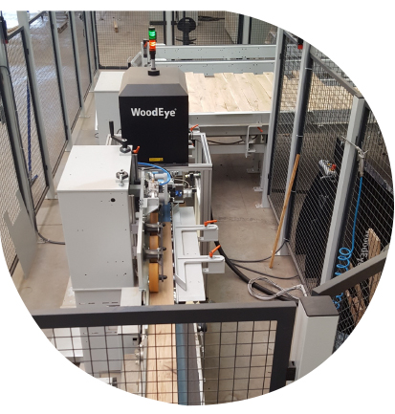
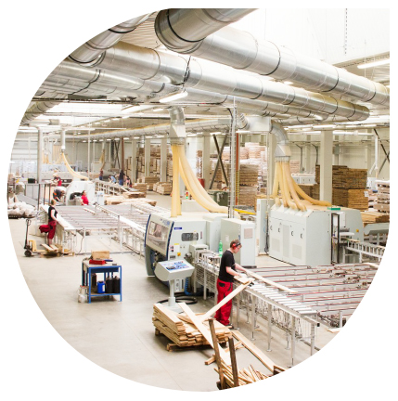
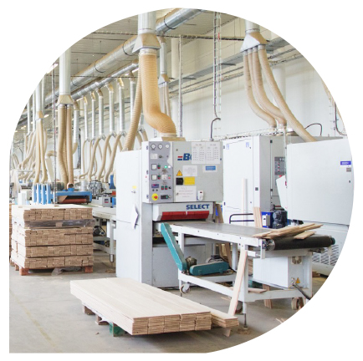
Our strengths
CRAFTMANSHIP
by experienced, highly trained and motivated staff
CONTINUOUS SUPPLY
of raw material with on-going control on grading and humidity
SUSTAINABILITY
purchase according to PEFC chain-of-custody
INVESTMENT
All facilities are acclimatized and have modern machinery
STANDARDIZED OFFER
standard supply solid wood

Slide 19
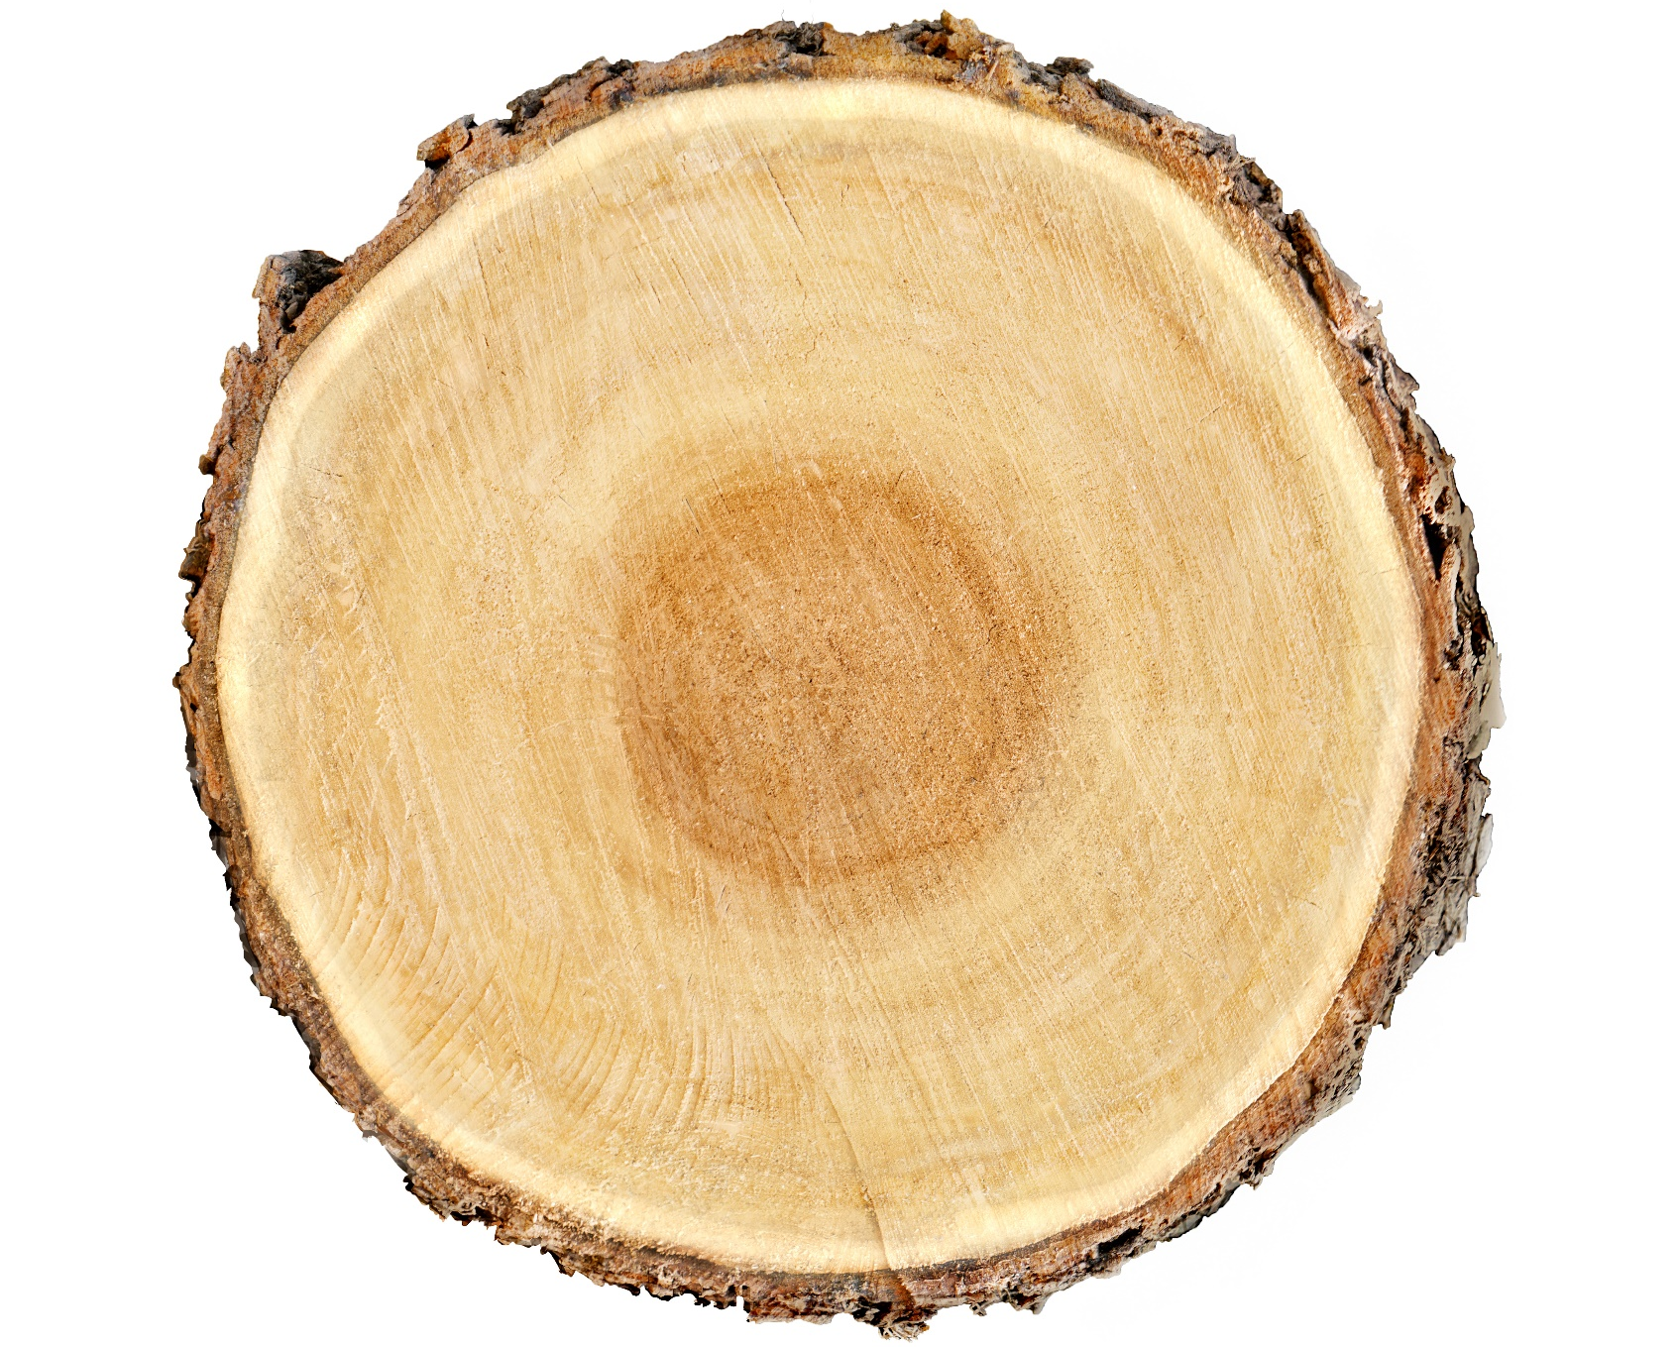
Production concept
only European oak
3 widths: 90mm – 120mm – 150mm
thickness: 15 mm
1 grading: ABC mixed ‘rustic’
UV oiled high quality applications
lacquered
average lengths up to 1.100mm
standard Tongue and Groove (click possible)

Slide 20
Lamett Europe
Ter Donkt 2
8540 Deerlijk
Belgium
info@lamett.eu
www.lamett.eu

